Slide 1
Unit 2: role of governments in financial markets
Dr. Dipendra Karki

Slide 2

Unit
Role of Governments in Financial Markets
2
The purpose of this chapter is to study the regulatory environment that governments around the world have created for financial-service firms in an effort to safeguard the public’s interest, bring stability to the financial system, and prevent abuse of financial service customers.

Slide 3
Regulation of Financial Markets
Regulation: rules enforced by federal and state agencies governing their;
Operations
Service offerings
Credit quality & quantity
Capital positions*
varying ways; because of differences in culture and history.
Heavy regulation: designed primarily to protect the public interest*
Role of governments:
Regulate financial markets
Act as financial intermediaries by making loans or guaranteeing loans
Influence financial markets at the macroeconomic level through the actions of their central banks.
Provide bailouts or financial assistance during periods of market distress.
FDIC- (Saying’’’’’)

Slide 4
Regulation of Financial Markets
Governments, issuers, and investors interact and affect one another’s actions in certain ways.
The market’s reactions to regulations often prompt a new response by the government, which can cause the institutions in the market to change their behavior further, and so on.
In their regulatory capacities; they greatly influence the development & evolution of fin. markets & institutions.
Justification for regulation:
to prevent issuers of securities from defrauding investors.
to promote competition and fairness in trading
to promote the stability of financial institutions
to limit or restrict the activities of foreign concerns in domestic markets
to control the level of economic activities.
Efficiency and low cost production
To prevent market failure

Slide 5
Forms of Regulation
Disclosure regulation: It requires issuers of securities to make it public and provide a large amount of financial information to investors.
Financial activity regulation: It relates to the rules about trading financial assets.
Regulation of financial institutions: It is the governmental monitoring and supervision that restricts these institutions’ activities in the vital areas of lending, borrowing, and funding.
Regulation of foreign participants: It is the form of governmental activity that limits the roles of foreign firms in the domestic market.
Banking and monetary regulation: It is concerned to control the changes in a country’s money supply to regulate the national economy*.
M1, M2, QTM (MV = PT)

Slide 6
Macroprudential Vs. Microprudential Government Policies
Macroprudential Government Policies
focus on the stability of the financial system as a whole
aimed at preventing the build-up of systemic risks that could threaten the stability of the entire financial system.
eg. regulations on the size of FIs, limits on the amount of leverage that can be used, and stress tests to assess the resilience of the financial system to different types of shocks*.
Microprudential Government Policies
aim to prevent the failure of individual institutions
aimed at regulating individual financial institutions and ensuring their stability in dealing with unsystematic or idiosyncratic risks.
eg. regulations on capital requirements, liquidity requirements, and risk management practices.
Providing liquidity at the time of distress, bailouts, OMO: Repo, Inflation, Interest rate corridor….
CAR, CRR, SLR,CD

Slide 7
Macroprudential Vs. Microprudential Government Policies
After the global financial crisis (2008), policymakers focused on macroprudential policies, mainly due to the following causes of GFC:
excessive use of leverage and risk-taking,
a bubble in the pricing of assets in a key sector of the financial market (residential property),
regulatory and supervisory failures, and
widespread failure of market discipline.
Matter of debate
tools available to governments for implementing such policies
the impediments and challenges to the implementation of those tools
questions regarding whether governments should establish one or share the responsibility among several supervisory entities.
When a single supervisory entity is designated, that entity is typically the country’s central bank.

Slide 8
Role of Central Bank in Financial Markets
The primary role of a central bank is to maintain financial stability through the money supply
The purpose of central banks
Risk assessment
Risk reduction
Oversight of payment systems
Crisis management
Monetary policy: objectives are
Price stability (US: 2% inflation)
Maximum employment (u. 5.2 to 5.8%)
Moderate interest rate
Lender of the last resort
Currency management
Financial stability
Payment systems
Foreign exchange reserves
Regulatory oversight
Research and analysis
Financial education
Bank supervision

Slide 9
Role of Central Bank in Financial Markets
Instruments of monetary policy
Reserve requirements: CRR, SLR
Open market operations (OMO): REPO
Discount rate: discount window
Money: a financial asset that is universally accepted as a means of transactions and settlement of debt
serves as a unit that to measure wealth
money has a store value
Types of Money Supply
Narrow Money Supply (M₁) : includes the most liquid form of money. It includes currency with the public (CP) and demand deposits (DD) held at commercial banks.
M1 = CP + DD
-It is the medium of exchange in the economy.
Broad Money Supply (M₂) : includes M1 plus time deposits (TD) held at comm. banks.
M₂ = M₁ + TD
= CP + DD + TD
-It takes into account the store value of money.

Slide 10
Demand for money
M₃: M₂ plus large time deposits and longer-term repurchase agreements issued by all depository institutions, Longer term foreign U.S. dollar deposits (Eurodollar).
L (liquid assets) : M₃ plus the non-bank public’s holdings (bonds, Treasury securities, commercial paper, banker’s acceptances)..
Demand for money
Quantity theory of money (QTM): classical theory by Fisher (1930)
-used as a medium of exchange only
-Fractional banking system
MV = PT
(M= qty. of money, V= velocity of money, P= price level, T= Volume of transactions)
M^{d} = 1/V (PT)------- (i)
-V is an institutionally determined variable,… , assumed constant
-So, demand for money is a certain percentage of the volume of transactions in the economy
Neo-classical theory: added the store of value function to the QTM.
Keynesian Demand for money: 3 purpose
-Transaction, precautionary & speculative

Slide 11
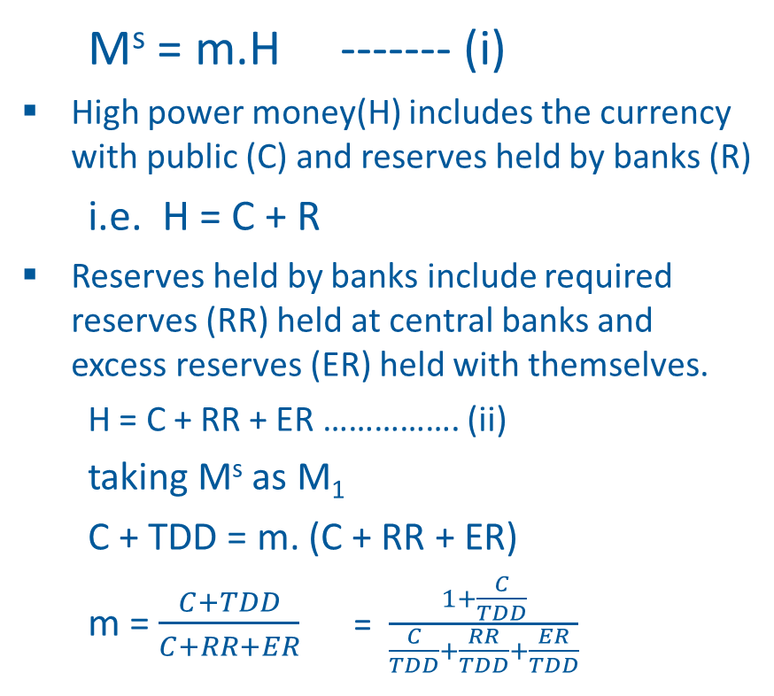
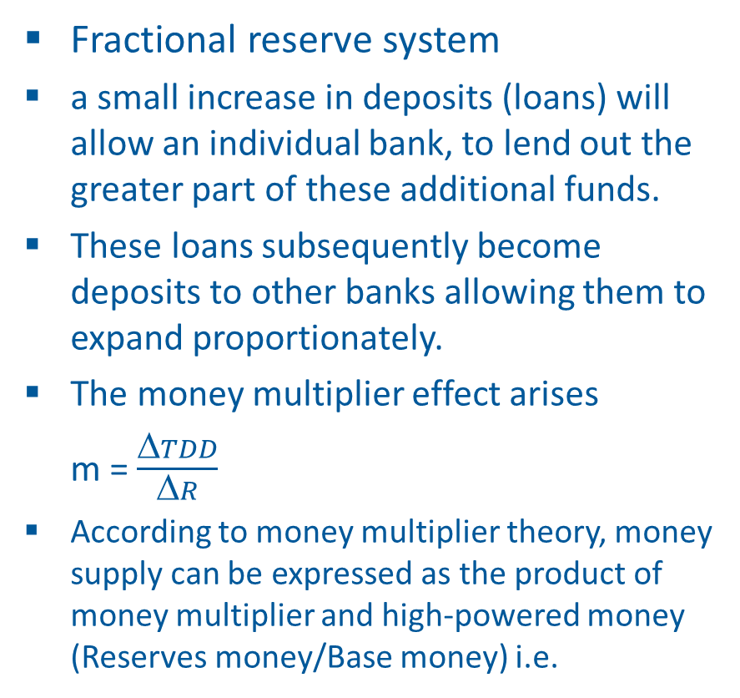
The money multiplier
Fractional reserve system
a small increase in deposits (loans) will allow an individual bank, to lend out the greater part of these additional funds.
These loans subsequently become deposits to other banks allowing them to expand proportionately.
The money multiplier effect arises
m = $\frac{ΔTDD}{ΔR}$
According to money multiplier theory, money supply can be expressed as the product of money multiplier and high-powered money (Reserves money/Base money) i.e.
M^{s} = m.H ------- (i)
High power money(H) includes the currency with public (C) and reserves held by banks (R)
i.e. H = C + R
Reserves held by banks include required reserves (RR) held at central banks and excess reserves (ER) held with themselves.
H = C + RR + ER ……………. (ii)
taking M^{s} as M₁
C + TDD = m. (C + RR + ER)
m = $\frac{C+TDD}{C+RR+ER}$ = $\frac{1+\frac{C}{TDD}}{\frac{C}{TDD}+\frac{RR}{TDD}+\frac{ER}{TDD}}$

Slide 12
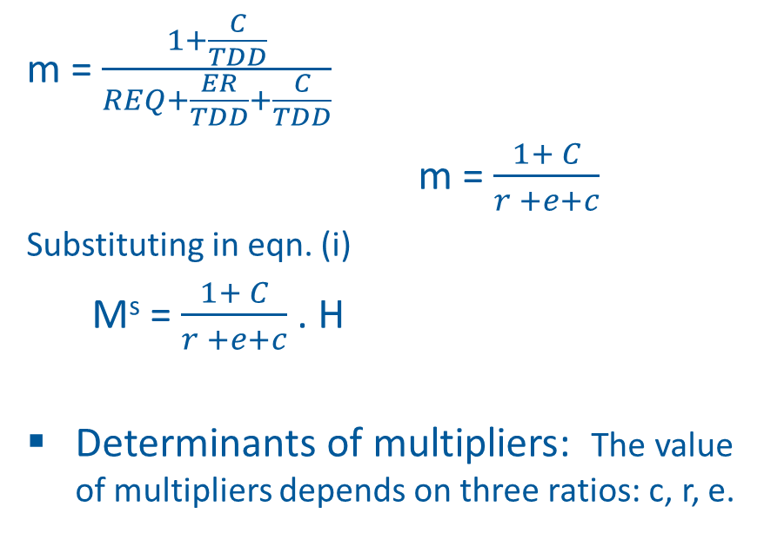
The money multiplier
m = $\frac{1+\frac{C}{TDD}}{REQ+\frac{ER}{TDD}+\frac{C}{TDD}}$
m = $\frac{1+ C}{r +e+c}$
Substituting in eqn. (i)
M^{s} = $\frac{1+ C}{r +e+c}$ . H
Determinants of multipliers: The value of multipliers depends on three ratios: c, r, e.
The impact of interest rate on money supply
If interest rate is higher, banks will be reluctant to keep higher excess reserve reducing excess reserve ratio. The value of money multiplier will be higher.
Public are more willing to keep deposits in banks for higher interest rate rather than to hold cash. This reduces c ratio and increases m.

Slide 13
Government Bailouts
Table 2.1. U.S. Govt. bailout by type
Type | Year
Nonfinancial corporations
Penn Central Railroad | 1970
Lockheed | 1971
Chrysler | 1980
Financial corporations
Franklin National Bank | 1974
Continental Illinois Bank and Trust | 1984
Bear Stearns | 2008
Fannie Mae and Freddie Mac | 2008
American International Group (AIG) | 2008
Citigroup | 2008
Bank of America | 2009
Industries
Savings and loan industry | 1989
Airlines industry | 2001
Automobile industry | 2008
Cities
New York City | 1974
Government bailouts are
financial assistance to prevent failure
provided to major industries, financial institutions, corporations, & subnational entities
viewed as essential to a country’s economy or financial system
In U.S., the two entities are responsible for the design and implementation of bailout plans.
U.S. Department of the Treasury &
the Fed

Slide 14
Forms of Bailouts
Bailouts may take various forms, including loans, guarantees, grants, or direct purchases of assets or equity.
a fed loan of $1.75 billion was provided to Franklin National Bank in 1974.
Fed provided JPMorgan Chase with a $30 billion line of credit to support the purchase ($236 m) of Bear Stearns.
AIG: several forms of financial assistance: an initial $85 billion line of credit with the Fed, followed by $110 billion in loans from the U.S. Department of the Treasury and $40 billion loan through TARP program
loan guarantee coupled with an equity position (stock warrant), allowing taxpayers to benefit from a recovery.
S&L industry (in 1989), govt. passed taxpayer-financed bailout legislation, which provided $50 billion to close failed S&Ls. Further, $78 billion.
Fannie Mae and Freddie Mac bailout: 1) a form of preferred stock. 2) warrants with 79.9% ownership stake.
Two banks: Citigroup and Bank of America received several forms of aid

Slide 15
Issues Associated with Government Bailouts
Protect the failure of ‘Too Big To Fail’
Interconnectedness
Systemic risk
Why Government need large banks
Economies of scale
Operational efficiency
What determines ‘Too Big To Fail’, Criticism:
In 2008, Bears and Stearns (market cap. ≅ 20 bn.) was rescued, however, LBH (asset size > 615 bn.) was allowed to fail.
The great depression was the result of systemic risk arising from the failure of many small banks
Opponents view
‘Fed put’ effect: management’ perception that government will rescue
Encourage them to take on excessive risks
Regulators will be reluctant to prosecute
Question: whether too big to fail is too ‘too big to solve’
Should no longer permit a bailout
Capital surcharge: for systemically important financial institutions (SIFI)
SIFI: Basel framework, Dodd-Frank Act
reduced granting liquidity that badly requires & increased collateral requirement
barred purchasing interest in banks by injecting public capital

Slide 16
Role of World Bank & IMF
WB: an international financial institution that was established in 1944
Primary goal: providing loans, technical assistance, & other financial services to developing countries to reduce poverty.
Providing financial assistance to developing countries
Promoting financial stability
Supporting the development of capital markets
Facilitating international cooperation
Providing research and analysis
Two components: 1) IBRD: International Bank for Reconstruction and Development, 2) IDA: International Development Association
IMF: established in 1944
Primary goal: promoting international monetary cooperation and exchange rate stability,
facilitating the balanced growth of international trade
providing resources to help member countries facing economic difficulties.
Providing policy advice and technical assistance to member countries
promoting global financial stability

Slide 17
Bank for International Settlement (BIS)
International financial organization to foster intl. cooperation, estb. 1930
Bank for central banks: Providing banking services to central banks and other international organizations
Facilitating international monetary and financial cooperation
Acting as a hub for standard-setting and regulatory cooperation
BIS has four standing Committees:
Basel Committee on Banking Supervision
The Committee on the Global Financial System
The Comm. on Payment & Settlement Systems
The Markets Committee
Asian Infrastructure Investment Bank (AIIB)
Multilateral development bank that was established in 2016 to:
finance infrastructure projects in Asia and beyond.
invest in infrastructure projects such as energy, transportation, & telecommunications.
improve regional connectivity, promote economic development, & reduce poverty in Asia.
promote sustainable development aligning with UN-SDG
promote regional cooperation & integration in Asia.

Slide 18
Financial Stability Board (FSB)
international body that monitors the global financial system, established in 2009.
makes policy recommendations to governments
assess vulnerabilities affecting the global financial system
promote coordination and information exchange among authorities
monitor and advise on market developments and their policy implications
advise on and monitor best practices in meeting regulatory standards
undertake joint strategic reviews of the policy development work
In Nov. 2011, the FSB published a set of policy measures addressing the systemic and moral hazard risks associated with SIFIs
View on Government Intervention
The first view, there should be large-scale govt. interventions to solve problems that involve massive market failures.
The second view is that govt. intervention is the problem, not the solution, which may lead to market failures by implementing policies that are not beneficial to fin. mkts.
as financial markets develop, there is development of a more sophisticated financial system, beyond regulation
Joseph Stiglitz (2001 noble prize recipient):
“The occurrence of modern capitalism is the link between financial crises and economic recessions”.
Deregulation of financial markets enables the financial system to more efficiently allocate capital.

